Slide 1

Home Taste
Stanley Pena
Jeremy Yu
Qiuqun Wang
Rod Ta

Slide 2
Motivation and Purpose
Our goal is to have cooking as easy as ordering food
Cooking can be hard for many people because people often don't plan out their meal until they realize they are hungry. This is why easy, on-the-go fast food is so popular, even when people have easy access to a stove and some fresh ingredients.
So why do people still want to dine out or order food instead of cooking on their own?
Our guess is that it’s not that people are too lazy to cook but it’s that they are too lazy to plan it out.
A home cooked meal can be very easy if one can have all the ingredients ready and all the steps planned out, which is often not the case. People often just start cooking unprepared and often the meal turns out not the way they wanted it to.
Purpose: Deliver a service in which the user could use to plan out their meal.
There are two main feature of the app
Allow the user to organize their personal recipes or browse the web for a new one to add to their collection of recipes
Plan out their weekly meal plan base on the recipes the user have in his/her collection
Users:
Anyone Who enjoys cooking or want to start cooking
Chefs and restaurant managers
Notes:
Pitch your application
What is the problem?
What is your solution?
What is the motivation for the idea?
What does the app do?
Who would want to use it?

Slide 3
Competitors
There are few competitors that we have discovered while researching about the idea.
One of the our biggest competitor is “Big Oven”
Provide recipe browsing and creating service
Provide meal planning service
However, you have to pay in order to use their meal planning service
We want to focus mainly on meal planner rather than recipe browsing and expand on that.
There are also other features we thought of but we don’t know if we will have the time to implement them all
Notes:
What are the current alternatives?
Why is another solution needed?
How do you differ?
How are you complementary?
Do you fit into an ecosystem?

Slide 4
Design Strategy
Our first step in creating the web application was designing the database. We want to have a clear idea on how information was going to be stored and accessed.
We are first implementing the homepage where we have a search bar, that allows users to search for recipes and instructions on how to make them.
We manage our project by constantly communicating our ideas and suggestions through our slack channel. Before we move on to do something, we discuss it with everyone else and see what their opinion is.
Each member is assigned with a specific section of the web application.
Notes:
What did you design first?
What are you implementing first?
How do you manage the project?
How do you split the workload amongst group members?

Slide 5
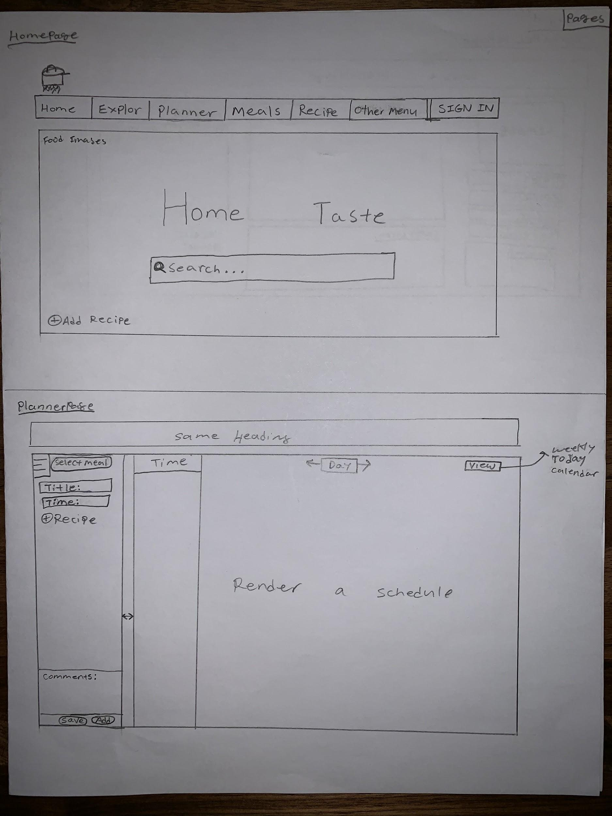

Slide 6
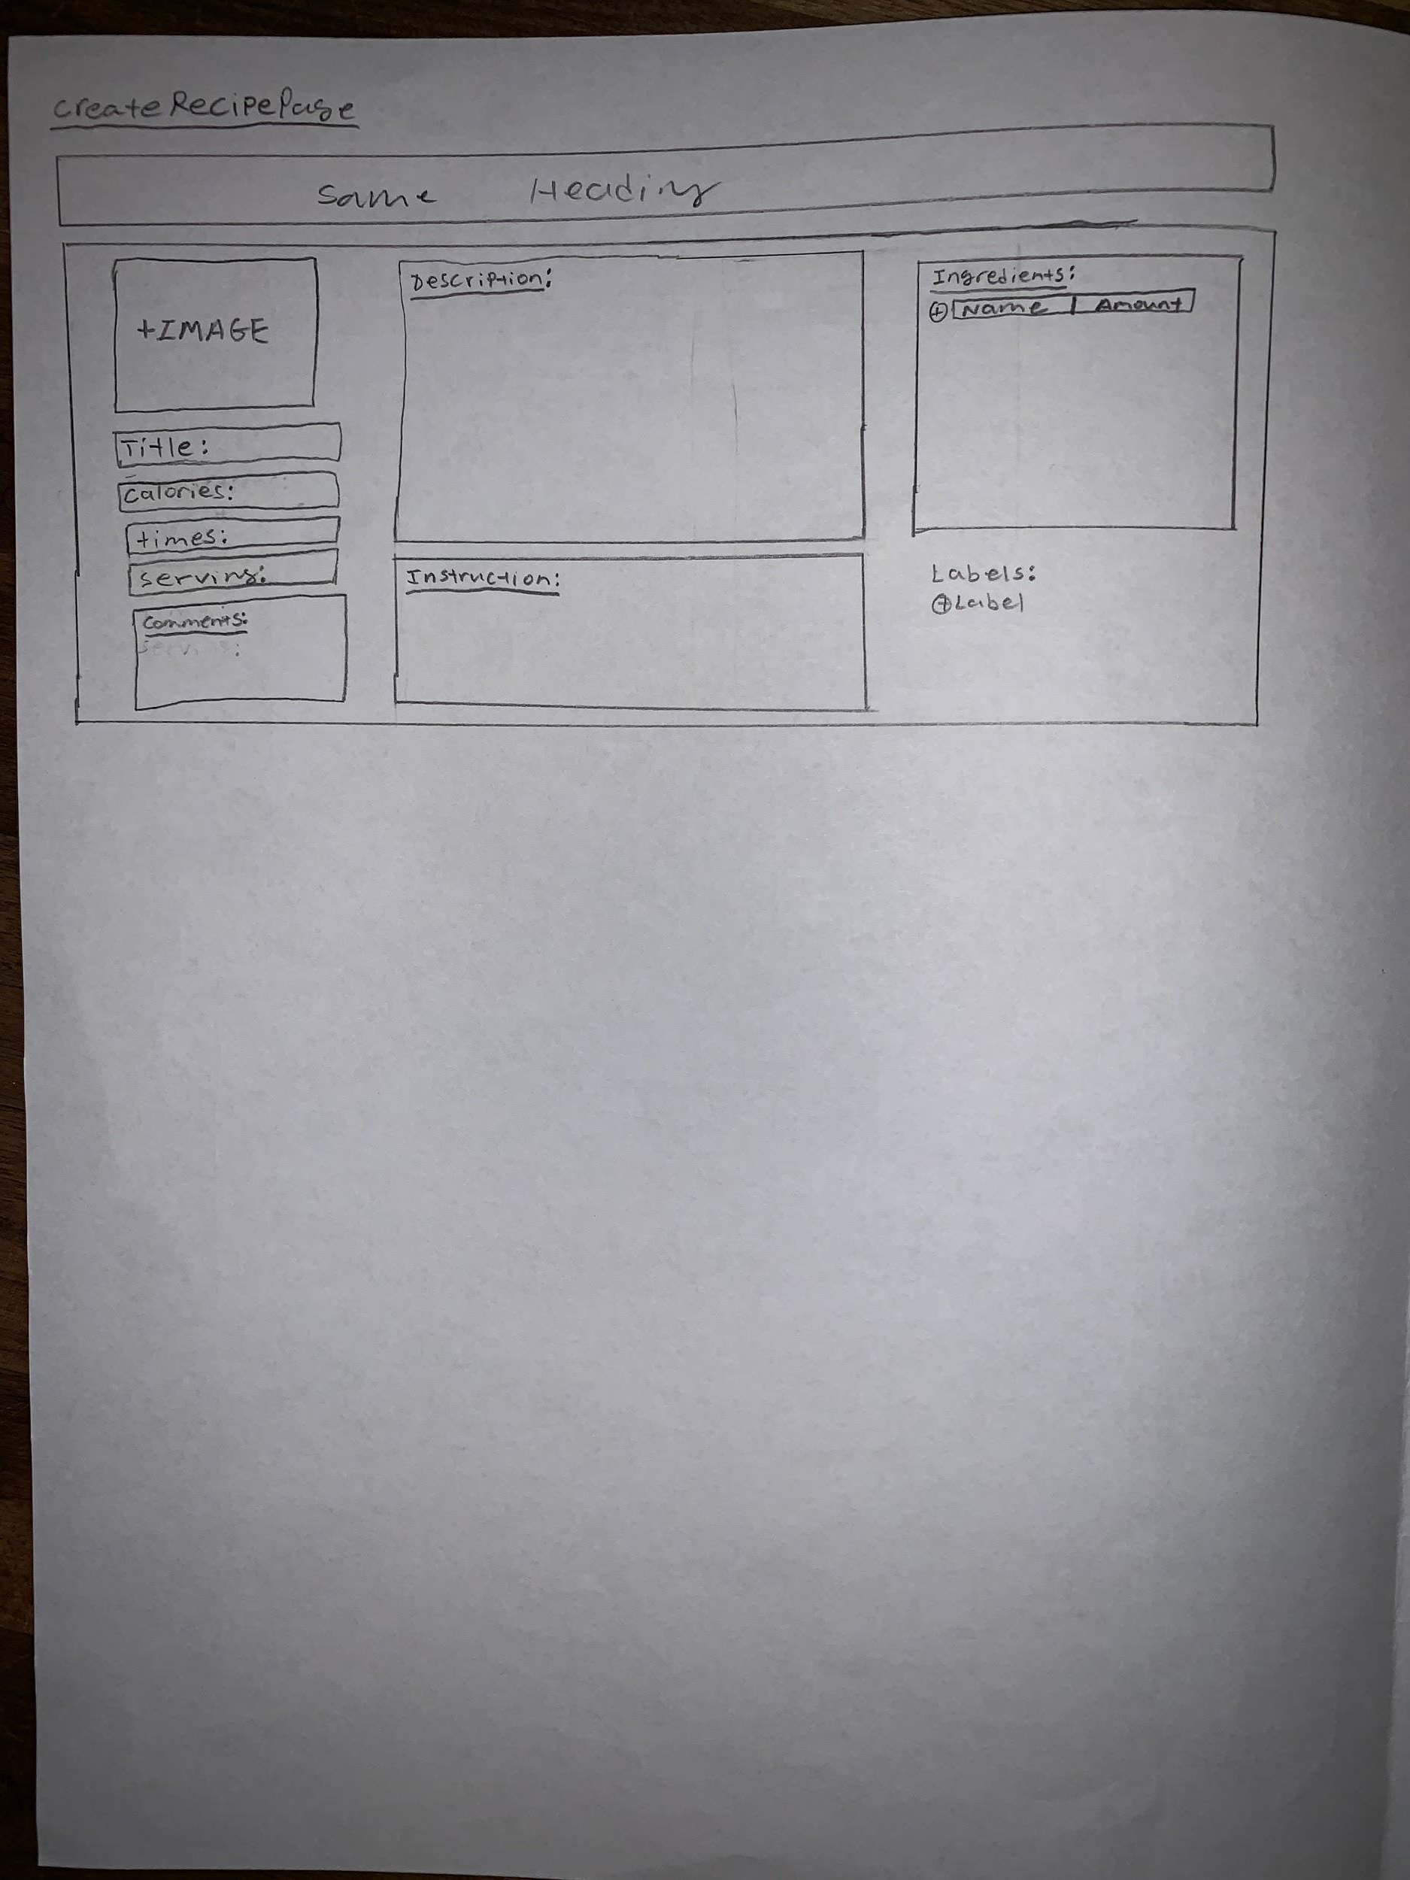

Slide 7
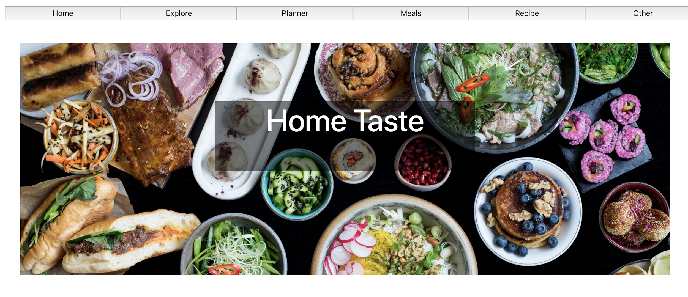

Slide 8
Technical Overview
What are your Resources?
-We are going to use the Edamam API to retrieve recipes when the users are browsing
What Controllers and Models did you design?
What Tests have you written or planned?
Notes:
What are your Resources?
What Controllers and Models did you design?
What Tests have you written or planned?

Slide 9
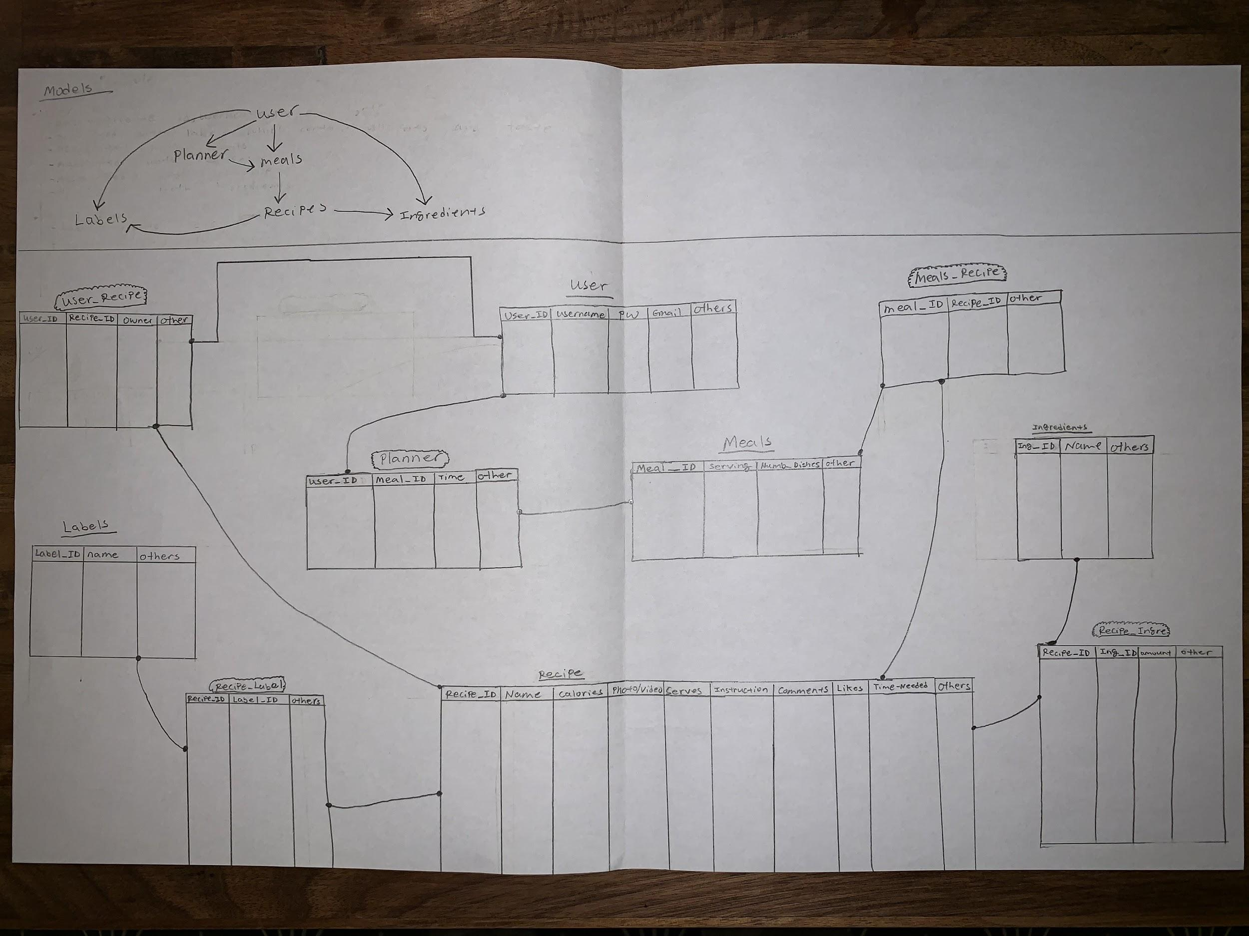

Slide 10
What’s Next?
What are you working on next?
We currently have everything planned out and designed on paper. We are going to start working on developing the website now.
Peer Programming on Saturdays
What technologies do you still need to learn/integrate into your project?
Getting more familiar with React, Express and Sequelize database

Slide 11
Any Feedback or Suggestions?

